Slide 1
Quality Control Part 1

Slide 2
Classification System for Human Computation
Motivation
Quality Control
Aggregation
Human Skill
Process Order
Task-request Cardinality

Slide 3
Quality Control
Crowdsourcing typically takes place through an open call on the internet, where anyone can participate. How do we know that they are doing work conscientiously? Can we trust them not to cheat or sabotage the system? Even if they are acting in good faith, how do we know that they’re doing things right?
Notes:
They might misunderstand the directions or make mistakes due to personal bias or lack of experience with the subject matter.

Slide 4
Different Mechanisms for Quality Control
Aggregation and redundancy
Embedded gold standard data
Reputation systems
Economic incentives
Statistical models

Slide 5
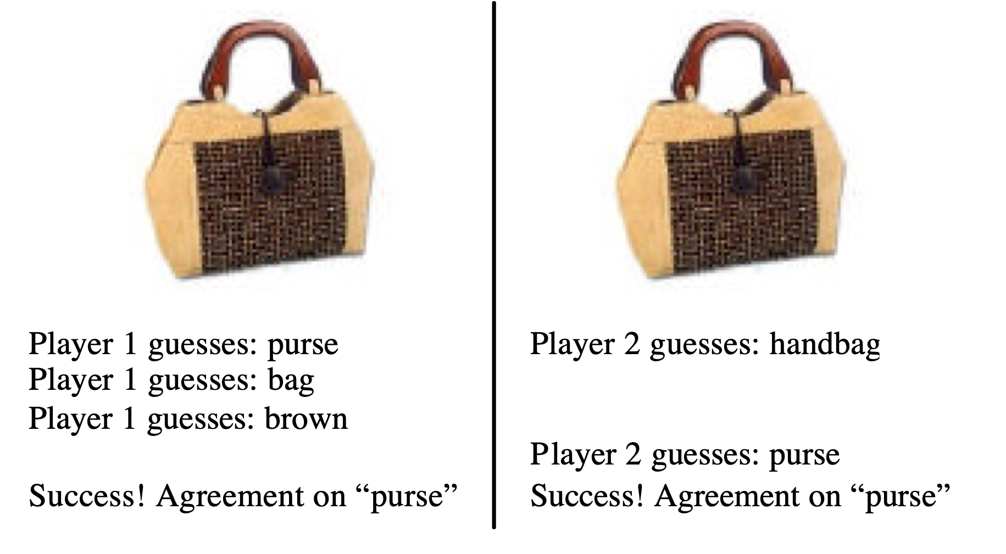
ESP Game
“think like each other”

Slide 6
Rules
Partners agree on as many images as they can in 2.5 minutes
Get points for every image, more if they agree on 15 images
Players can also choose to pass or opt out on difficult image
If a player clicks the pass button, a message is generated on their partner’s screen; a pair cannot pass on an image until both have passed

Slide 7
Taboo Words
Players are not allowed to guess certain words
Taboo words are the previous set of agreed upon words (up to 6)
Initial labels for an image are often general ones (like “man” or “picture”)
Taboo words generate more specific labels and guarantee that images get several different labels
Notes:
Also blocks taboo words’ singular/plural

Slide 8
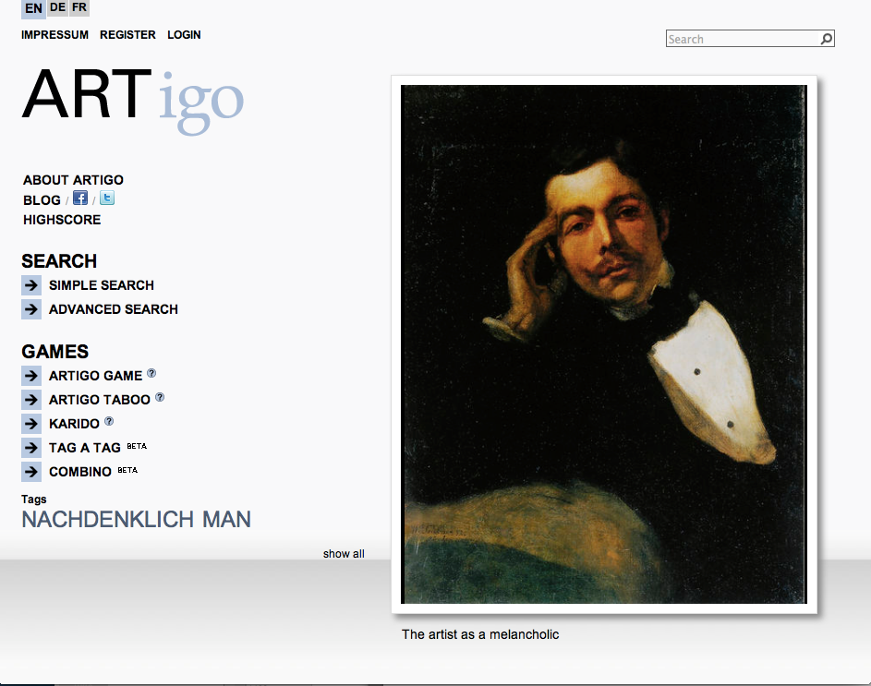
http://www.artigo.org
Notes:
http://www.artigo.org for current demo

Slide 9
Game stats
For 4 months in 2003, 13,630 people played the ESP game, generating 1,271,451 labels for 293,760 different images
3.89 labels/minute from one pair of players
At this rate, 5,000 people playing the game 24 hours a day would label all images on Google (425,000,000 images) with 1 label each in 31 days
In half a year, 6 words could be associated to every image in Google’s index

Slide 10
ESP’s Purpose is Good Labels for Search
Labels that players agree on tend to be “better”
ESP game disregards the labels that players don’t agree on
Can run the image through many pairs of players
Establish a threshold for good labels (permissive = 1 pair agrees, strict = 40 agree)

Slide 11
Are they any good?
Are these labels good for search?
Is agreement indicative of better search labels?
Is cheating a problem for the ESP game?
How do they counter act it?

Slide 12
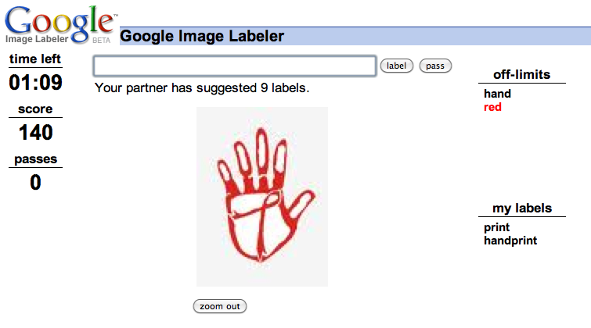
Notes:
https://en.wikipedia.org/wiki/Google_Image_Labeler
Less than a month after the launch, the game began to be abused.[6] It appeared that Google was getting spammed with words from the following list:
abrasives, accretion, bequeathing, carcinoma, congenita, diphosphonate, entrepreneurialism, forbearance, and googley.
Because players could see the responses of their partner at the end of each round, they learned that other players were using these words. Some then incorporated these words into their answers for entertainment and increased scores.
On or before February 7, 2007, Google changed the game to cut down on the abuse. The words on the list above were filtered out. Also, certain images that had become triggers for the random words came with an immediate "Your Partner Wants to Pass." In the game revision of March 13, 2007, the "trigger images" were temporarily removed.

Slide 13
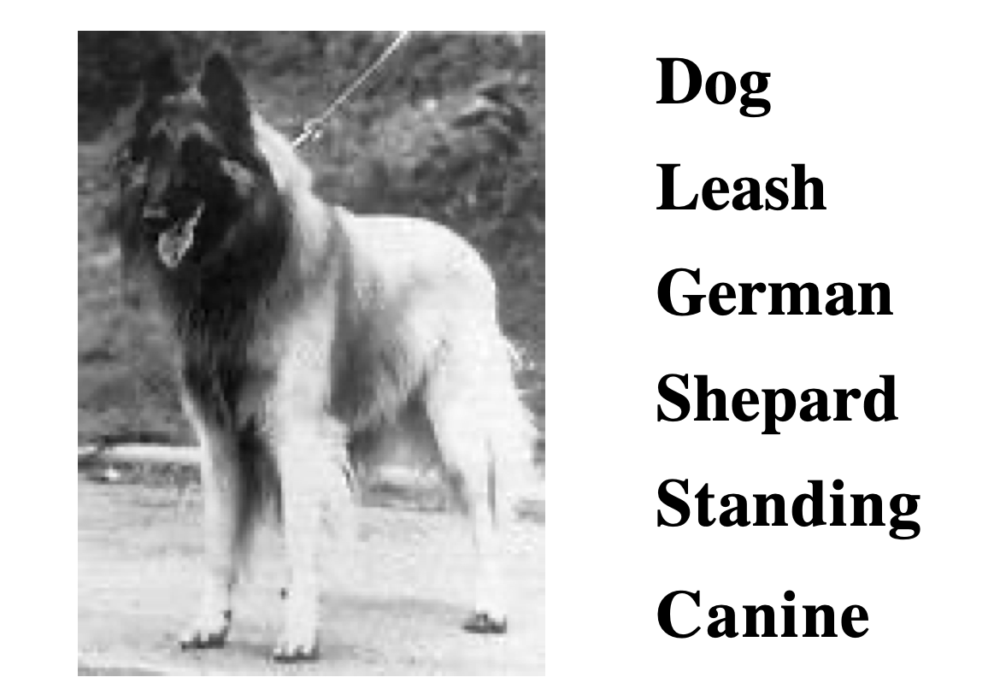
Original Evaluation
Pick 20 images at random that have at least 5 labels
15 people the images and agreed on labels
Do these have anything to do with the image?
Notes:
Success – 85% are good.

Slide 14
When is an image done?
When it accumulates enough keywords not to be fun anymore
System notes when an image is repeatedly passed
Can re-label images at a future date to see if their labels are still timely and appropriate

Slide 15
Pre-recorded game play
The server records the timing of a session between two people
Each side can be used to play with a single player in the future
Especially useful when game is gaining in popularity

Slide 16
Cheating in ESP
Partners cannot communicate with each other, so cheating is hard
Could propagate a strategy on a popular web site (“Let’s always type A”)
Randomly paired players and pre-recorded game play make it hard

Slide 17
Ground Truth
Notes:
Task-based evaluation v. ability to recreate gold standard labels

Slide 18
Ability to produce labels of expert quality
Measure the quality of labels on an authoritative set
How good are labels from non-experts compared to labels from experts?

Slide 19
Fast and Cheap – But is it Good?
Snow, O’Conner, Jurafsky and Ng (2008)
Can Turkers be used to create data for natural language processing?
Measured their performance in a series of well-designed experiments

Slide 20
NLP Annotation
Affect Recognition
Word Similarity
Textual Entailment
Word Sense
Temporal Annotation
fear(“Tropical storm forms in Atlantic”) > fear(“Goal delight for Sheva”)
sim(lad, boy) > sim(rooster, noon)
if “Microsoft was established in Italy in 1985” then “Microsoft was established in 1985”?
“a bass on the line” v. “a funky bass line”
collapsed happens before explosion in:
“The building collapsed in the wake of the massive explosion.”

Slide 21
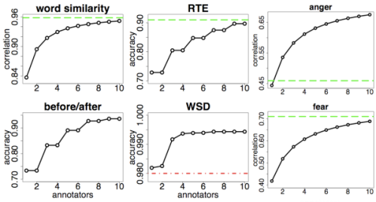
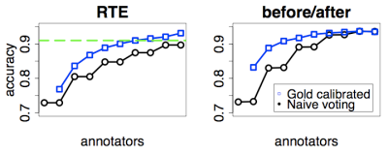
NLP Annotation
Snow et al (EMNLP 2008)
Combine non-expert judgments for high correlation with experts
Weight w/ small amount of gold standard data for better results
Cost to gather 21,000 labels
for five NLP tasks
$
25.
82

Slide 22
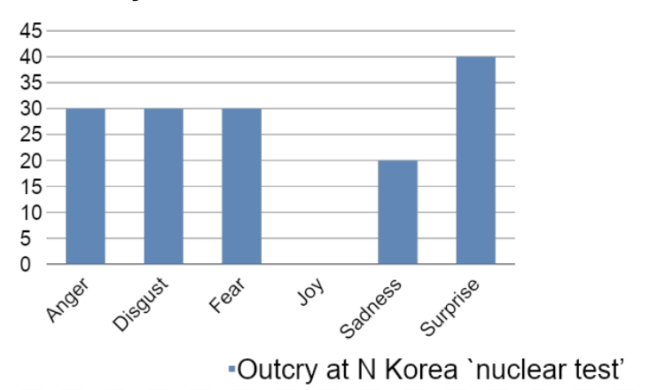
Affect Recognition
Turkers are shown short headlines
Given numeric scores to 6 emotions

Slide 23
Affect Recognition Goals
Sentiment Analysis – enhance the standard positive/negative analysis with more nuanced emotions
Computer assisted creativity – generate text for computational advertising or persuasive communication
Verbal expressively for speech-to-text generation – improve the naturalness and effectiveness of computer voices

Slide 24
Word Similarity
Give a subjective numeric score about how similar a pair of words is
30 pairs of related words like {boy, lad} and unrelated words like {noon, string}
Used in psycholinguistic experiments
sim(lad, boy) > sim(rooster, noon)
Notes:
The relationship between semantic and contextual similarity is investigated for pairs of nouns that vary from high to low semantic similarity. Semantic similarity is estimated by subjective ratings; contextual similarity is estimated by the method of sorting sentential contexts. The results show an inverse linear relationship between similarity of meaning and the discriminability of contexts. This relation, is obtained for two separate corpora of sentence contexts. It is concluded that, on average, for words in the same language drawn from the same syntactic and semantic categories, the more often two words can be substituted into the same contexts the more similar in meaning they are judged to be.
http://www.citeulike.org/user/dingdong1104/article/2762991

Slide 25
Word Sense Disambiguation
Read a paragraph of text, and pick the best meaning for a word
Robert E. Lyons III was appointed president and chief operating officer...
1) executive officer of a firm, corporation, or university 2) head of a country (other than the U.S.) 3) head of the U.S., President of the United States
Notes:
The relationship between semantic and contextual similarity is investigated for pairs of nouns that vary from high to low semantic similarity. Semantic similarity is estimated by subjective ratings; contextual similarity is estimated by the method of sorting sentential contexts. The results show an inverse linear relationship between similarity of meaning and the discriminability of contexts. This relation, is obtained for two separate corpora of sentence contexts. It is concluded that, on average, for words in the same language drawn from the same syntactic and semantic categories, the more often two words can be substituted into the same contexts the more similar in meaning they are judged to be.
http://www.citeulike.org/user/dingdong1104/article/2762991

Slide 26
Recognizing Textual Entailment
Decide whether one sentence is implied by another
Is “Oil prices drop” implied by “Crude Oil Prices Slump”?
Is “Oil prices drop” implied by “The government announced that it plans to raise oil prices”?

Slide 27
Temporal Annotation
Did a verb mentioned in a text happen before or after another verb?
It just blew up in the air, and then we saw two fireballs go down to the water, and there was smoke coming up from that.
Did go down happen before/after coming up?
Did blew up happen before/after saw?

Slide 28
Experiments
These data sets have existing labels that were created by experts
We can therefore measure how well the workers’ labels correspond to experts
What measurements should we use?

Slide 29
Correlation
Headline | Expert | Non-expert
Beware of peanut butter pathogens | 37 | 15
Experts offer advice on salmonella | 23 | 10
Indonesian with bird flu dies | 45 | 39
Thousands tested after Russian H5N1 outbreak | 71 | 80
Roots of autism more complex than thought | 15 | 20
Largest ever autism study identifies two genetic culprits | 12 | 22
Notes:
Here are a list of headlines with the Fear score for experts, non-experts.

Slide 30
Kendall tau rank correlation coefficient
τ = (number of concordant pairs) - (number of discordant pairs)
1/2 n*(n-1)
Headline | Expert | Non-expert
Beware of peanut butter pathogens | 37 | 15
Experts offer advice on salmonella | 23 | 10
Concordant
>
>
Notes:
What’s the range of possible values for tau?

Slide 31
Kendall tau rank correlation coefficient
τ = (number of concordant pairs) - (number of discordant pairs)
1/2 n*(n-1)
Headline | Expert | Non-expert
Experts offer advice on salmonella | 23 | 10
Largest ever autism study identifies two genetic culprits | 12 | 22
discordant
>
<

Slide 32
Kendall tau rank correlation coefficient
τ = (number of concordant pairs) - (number of discordant pairs)
1/2 n*(n-1)
τ = 11 - 4 = 0.46
15

Slide 33
Fast and Cheap – But is it Good?
Snow, O’Conner, Jurafsky and Ng (2008)
Can Turkers be used to create data for natural language processing?
Measured their performance in a series of well-designed experiments

Slide 34
Experiments galore
Calculate a correlation coefficient for each of the 5 data sets by comparing the non-expert values against expert values
In most cases there were multiple annotations from different experts – this let’s us establish a topline
Instead of taking a single Turker, combine multiple Turkers for each judgment

Slide 35
Sample sizes
Task | Labels
Affect Recognition | 7000
Word Similarity | 300
Recognizing Textual Entailment | 8000
Word Sense Disambiguation | 1770
Temporal Ordering | 4620
Total | 21,690

Slide 36
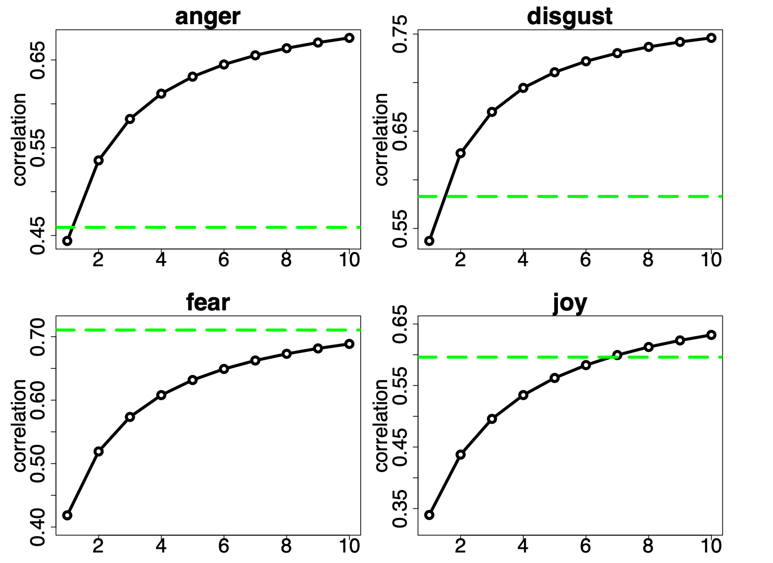
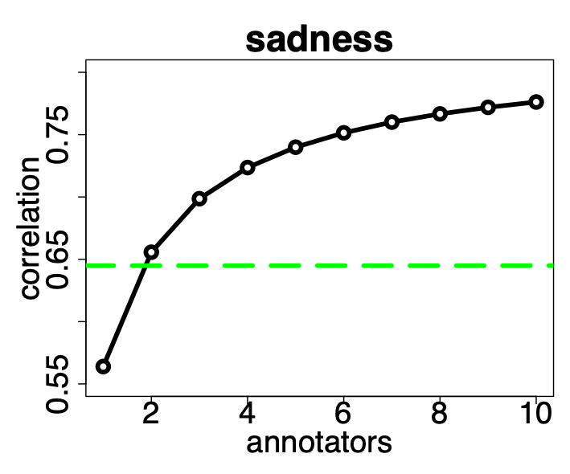
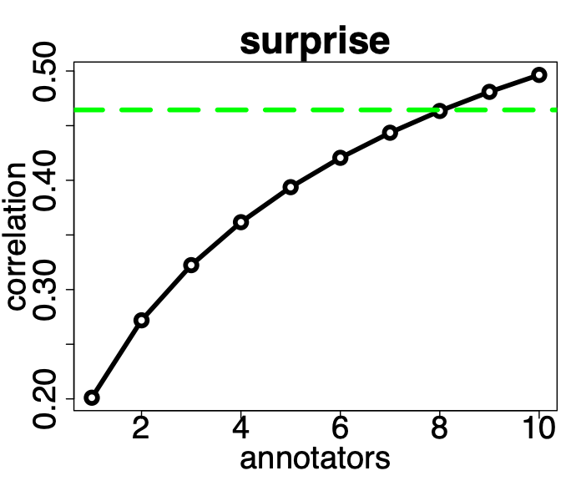
Agreement with experts increases as we add more Turkers
Notes:
X-axis is number of combined judgments
Green line is expert-expert correlation

Slide 37
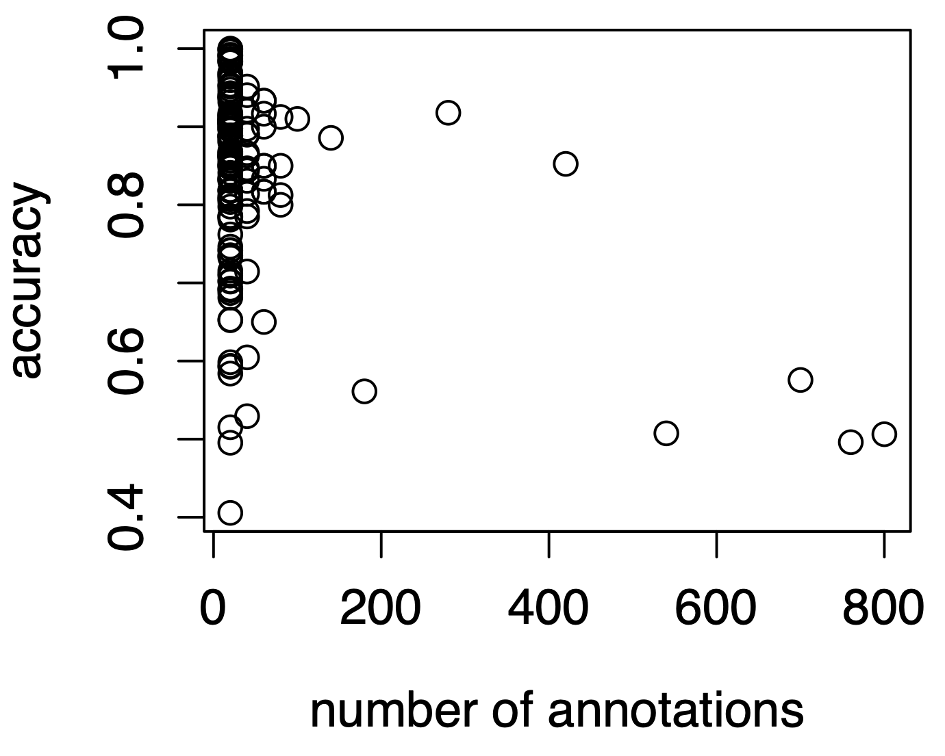
Accuracy of individual annotators
Notes:
What do you notice about this graph?
* A few annotators create most of the annotations
* People who do the most aren’t doing a good job

Slide 38
Calibrate the Turkers
Instead of counting each Turker’s vote equally, instead weight it
Set the weight of the score based on how well they do on gold standard data
Embed small amounts of expert labeled data alongside data without labels
Votes will count more for Turkers who perform well, and less for those who perform poorly

Slide 39
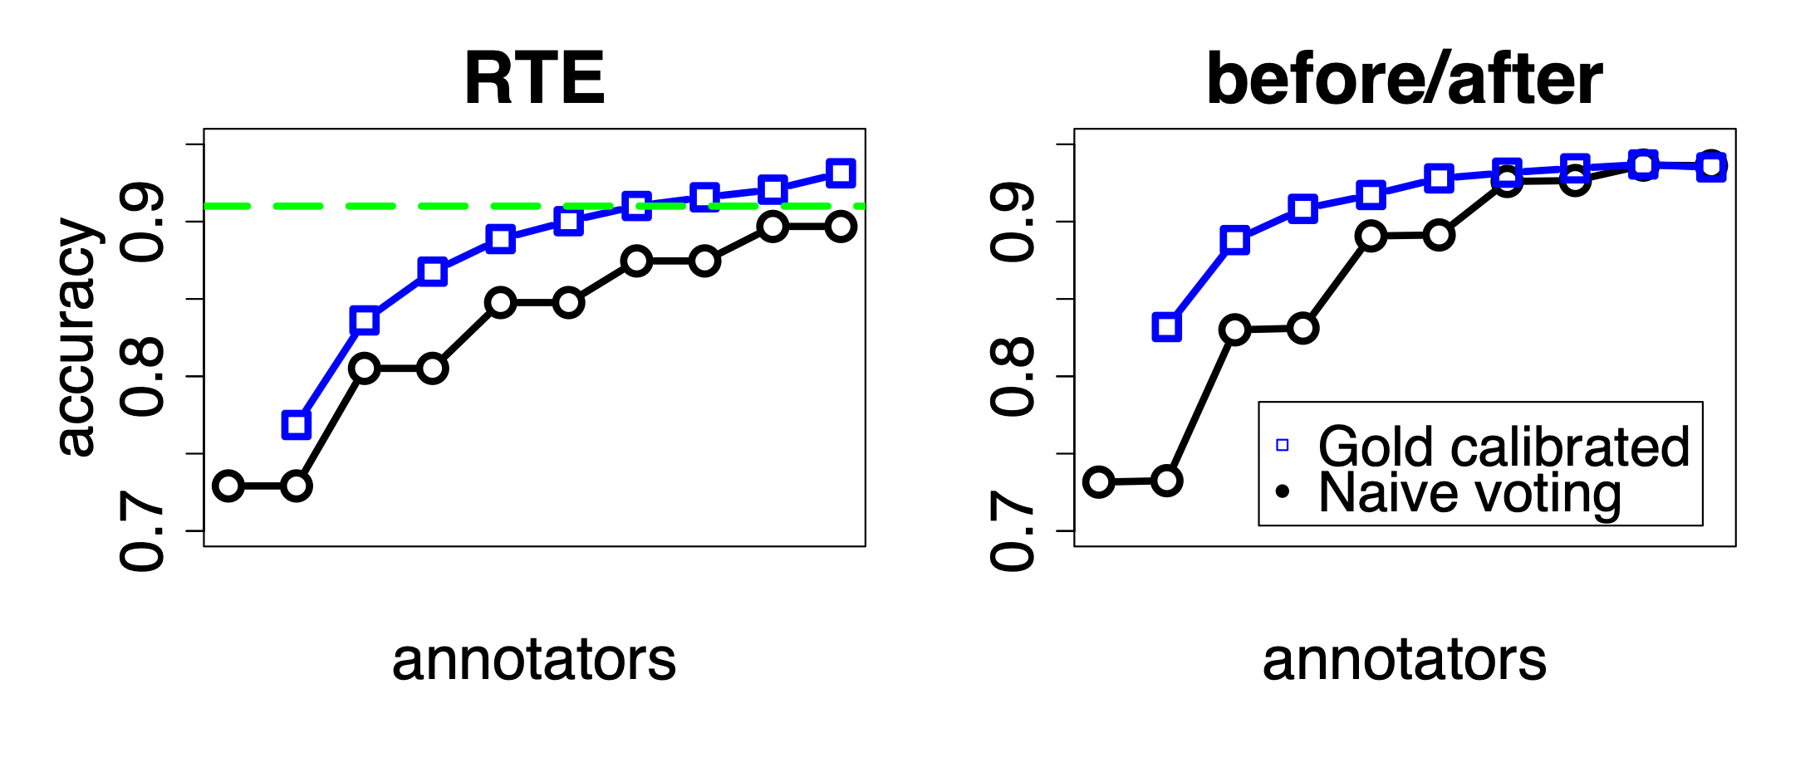
Weighted votes

Slide 40
Limitations?
Embedding gold standard data and weighted voting seems like the way to go
What are its limitations?

Slide 41
Limitations
Requires objective answers – it is difficult to measure accuracy of subjective responses
Applies mainly to structured data like multiple choice questions – things like content generation / free text responses can’t be calibrated in the same way
Higher costs – requires creation of gold standard data by experts, requires multiple Workers to do each item

Slide 42
QC: Second-pass review
Do second-pass grading when gold standard don’t allow automatic grading
Often times the second-pass HIT can be automatically gradable
This makes the whole pipeline fully automated and ensures high quality

Slide 43
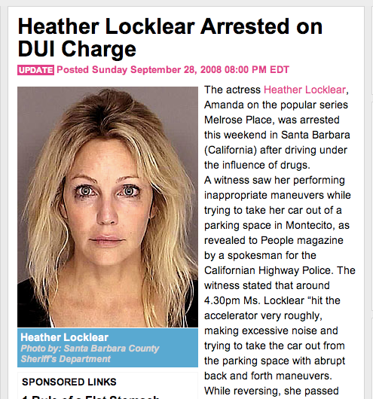
Was arrested actress Heather Locklear because of the driving under the effect of an unknown medicine
Why was Heather Locklear arrested?
Why did the bystander call emergency services?
Where did the witness see her acting abnormally?
Driving while medicated
There was a lot of noise
In a parking lot

Slide 44
Was arrested actress Heather Locklear because of the driving under the effect of an unknown medicine
Heather Locklear Arrested for
driving under the influence of drugs
Actress Heather Locklear was due to driving under the influence of an unknown drug arrested
. Medikamentes unknown have the effect of a fahrens under actress heather locklear arrested
Why was Heather Locklear arrested?
Why did the bystander call emergency services?
Where did the witness see her acting abnormally?
In Santa. One is, melrose place the series of the role of the 'remember the locklear actress the heather this weekend, because of the fahrens Barbara (California) in effect unknown medikamentes arrested People 'magazine. The traffic police California, spokesman for the auszufahren montecito reported in its way from tried parklücke type strange right, you have seen as a witness. . In some Zeitung, as and when they tried to a great deal of 30 p.m., witness the detail of history locklear after 16: that durchdrückte peddle noise and its progress was made parklücke for the car or moving backwards, they had they times of their sonnenbrille ' . The first was probably recognised that locklear a nearby road and anhielt, had not, with the witness to the car off

Slide 45
Heather Locklear Arrested for
driving under the influence of drugs
Why was Heather Locklear arrested?
She was arrested on suspicion of driving under the influence of drugs.
The actress Heather Locklear, Amanda of the popular series Melrose Place, was arrested this weekend in Santa Barbara (California) after driving under the influence of drugs. A witness viewed her performing inappropriate maneuvers while trying to take her car out from a parking in Montecito, as revealed to People magazine by a spokesman for the Californian Highway Police. The witness stated that around 4.30pm Ms. Locklear "hit the accelerator very violently, making excessive noise while trying to take her car out from the parking with abrupt back and forth maneuvers. While reversing, she passed several times in front of his sunglasses." Shortly after, the witness, who, in a first time, apparently had not recognized the actress, saw Ms. Locklear stopping in a nearby street and leaving the vehicle.
Driving under the influence
Driving while medicated
DUI
Driving while using drugs
Medikamentes

Slide 46
The art of designing good HITs

Slide 47
Crowdsourcing works for tasks that are
Natural and easy to explain to non-experts
Decomposable into simpler tasks that can be joined together
Parallelizable into small, quickly completed chunks
Well-suited to quality control (some data has correct gold standard annotations)

Slide 48
Crowdsourcing works for tasks that are
Robust to some amount of noise/errors (the downstream task is training a statistical model)
Balanced and each task contains the same amount of work
Don’t have tons of work in one assignment but not another
Don’t ask Turkers to annotate something occurs in the data <<10% of the time

Slide 49
Guidelines for your own tasks
Simple instructions are required
If your task can’t be expressed in one paragraph + bullets, then it may need to be broken into simpler sub-tasks

Slide 50
Guidelines for your own tasks
Quality control is paramount
Measuring redundancy doesn’t work if people answer incorrectly in systematic ways
Embed gold standard data as controls
Qualification tests v. no qualification test
Reduce participation, but usually ensures higher quality

Slide 51
Guidelines for your own tasks
Controls should be
Ones that have a unambiguous answer
Scorable automatically or with 2nd pass HIT
Not easily detectable

Slide 52
Guidelines for your own tasks
Remember that MTurk is a reputation system
Rejecting Turkers has consequences for them, blocking Turkers is likely to get them expelled form MTurk
I reject all work performing near chance, accept all work doing ~80%, reject proportionally to performance on controls for in-between

Slide 53
Guidelines for your own tasks
Reputation goes both ways
Monitor your profile on Turker Nation and TurkOpticon
Pay your workers generously
Pay quickly, and be responsive to email questions

Slide 54
Example HIT design: Reading Comprehension to evaluate Machine Translation systems

Slide 55
Evaluating Machine Translation
There are many MT systems available for each language pair
How do we know which one is best?
There is an active field of research focused on evaluating MT automatically
Reasoning: manual evaluation requires humans and is therefore too time consuming and expensive

Slide 56
Evaluating Machine Translation
I designed a pipelined HIT
First take foreign articles translated into English
Have Turkers write reading compare

Slide 57
Heather Locklear Arrested for
driving under the influence of drugs
Why was Heather Locklear arrested?
She was arrested on suspicion of driving under the influence of drugs.
Why did the bystander call emergency services?
He was concerned for Ms. Locklear’s life.
Where did the witness see her acting abnormally?
Pulling out of parking in Montecito
The actress Heather Locklear, Amanda of the popular series Melrose Place, was arrested this weekend in Santa Barbara (California) after driving under the influence of drugs. A witness viewed her performing inappropriate maneuvers while trying to take her car out from a parking in Montecito, as revealed to People magazine by a spokesman for the Californian Highway Police. The witness stated that around 4.30pm Ms. Locklear "hit the accelerator very violently, making excessive noise while trying to take her car out from the parking with abrupt back and forth maneuvers. While reversing, she passed several times in front of his sunglasses." Shortly after, the witness, who, in a first time, apparently had not recognized the actress, saw Ms. Locklear stopping in a nearby street and leaving the vehicle.

Slide 58
Why was Heather Locklear arrested in Montecito?
Because she was driving under the influence of drugs
Where was Locklear arrested?
In a parking lot in Montecito
Why was Heather Locklear arrested?
She was arrested on suspicion of driving under the influence
Why was Heather Locklear arrested in Montecito?
Because she was driving under the influence of drugs
What was Heather Locklear arrested for?
Driving under the influence of drugs

Slide 59
Heather Locklear Arrested for
driving under the influence of drugs
Was arrested actress Heather Locklear because of the driving under the effect of an unknown medicine
Why was Heather Locklear arrested?
She was arrested on suspicion of driving under the influence of drugs.
Heather Locklear Arrested for
driving under the influence of drugs
Actress Heather Locklear was due to driving under the influence of an unknown drug arrested
. Medikamentes unknown have the effect of a fahrens under actress heather locklear arrested
System | Correct Answers
Reference | 94%
Google | 80%
RBMT5 | 77%
Geneva | 63%
Tromble | 50%
The actress Heather Locklear that is known to the Amanda through the role from the series "Melrose Place" was arrested at this weekend in Santa Barbara (Californium) because of the driving under the effect of an unknown medicine. A female witness observed she attempted in quite strange way how to go from their parking space in Montecito, speaker of the traffic police of californium told the warehouse `People'. The female witness told in detail, that Locklear 'pressed `after 16:30 clock accelerator and a lot of noise did when she attempted to move their car towards behind or forward from the parking space, and when it went backwards, she pulled itself together unites Male at their sunglasses'. A little later the female witness that did probably not have Anfangs the actress Erkannt saw that Locklear stopped on a street seemed likely and the car got out.
The actress Heather Locklear, Amanda of the popular series Melrose Place, was arrested this weekend in Santa Barbara (California) after driving under the influence of drugs. A witness viewed her performing inappropriate maneuvers while trying to take her car out from a parking in Montecito, as revealed to People magazine by a spokesman for the Californian Highway Police. The witness stated that around 4.30pm Ms. Locklear "hit the accelerator very violently, making excessive noise while trying to take her car out from the parking with abrupt back and forth maneuvers. While reversing, she passed several times in front of his sunglasses." Shortly after, the witness, who, in a first time, apparently had not recognized the actress, saw Ms. Locklear stopping in a nearby street and leaving the vehicle.
The actress Heather Locklear, Amanda of the popular series Melrose Place, was arrested this weekend in Santa Barbara (California) after driving under the influence of drugs. A witness viewed her performing inappropriate maneuvers while trying to take her car out from a parking in Montecito, as revealed to People magazine by a spokesman for the Californian Highway Police. The witness stated that around 4.30pm Ms. Locklear "hit the accelerator very violently, making excessive noise while trying to take her car out from the parking with abrupt back and forth maneuvers. While reversing, she passed several times in front of his sunglasses." Shortly after, the witness, who, in a first time, apparently had not recognized the actress, saw Ms. Locklear stopping in a nearby street and leaving the vehicle.
Driving under the influence
Driving while medicated
DUI
Driving while using drugs
Medikamentes

Slide 60
Was arrested actress Heather Locklear because of the driving under the effect of an unknown medicine
Why was Heather Locklear arrested?
She was arrested on suspicion of driving under the influence of drugs.
Heather Locklear Arrested for
driving under the influence of drugs
Heather Locklear Arrested for
driving under the influence of drugs
3.
Actress Heather Locklear was due to driving under the influence of an unknown drug arrested
. Medikamentes unknown have the effect of a fahrens under actress heather locklear arrested
$
30
90 reading comprehension questions for 10 document
The actress Heather Locklear that is known to the Amanda through the role from the series "Melrose Place" was arrested at this weekend in Santa Barbara (Californium) because of the driving under the effect of an unknown medicine. A female witness observed she attempted in quite strange way how to go from their parking space in Montecito, speaker of the traffic police of californium told the warehouse `People'. The female witness told in detail, that Locklear 'pressed `after 16:30 clock accelerator and a lot of noise did when she attempted to move their car towards behind or forward from the parking space, and when it went backwards, she pulled itself together unites Male at their sunglasses'. A little later the female witness that did probably not have Anfangs the actress Erkannt saw that Locklear stopped on a street seemed likely and the car got out.
9.
Actress Heather Locklear, by the role of Amanda from the series "Melrose Place" is known, was this weekend in Santa Barbara (California) because of driving under the influence of an unknown drug arrested. A witness had observed how it quite strange way tried to park their extended gap in Montecito, reported spokesman for the traffic police from California to the magazine `People '. The witness told in detail that Locklear `after 16:30 clock durchdrückte pedal and a lot of noise made by trying to her car to the rear or front of the park gap to move, and when she went backwards, took it a few times in their Sunglass'. Somewhat later the witness saw the beginning of the actress probably had not recognized that Locklear on a nearby road and stopped the car exit.
The witness was the person who notified the emergency service because they fear for `live Locklear had '. When the police patrol arrived, they found the actress in her car seat, which is across the street to stand and thus blocked the traffic. `They seemed to be disoriented, so they brought the policemen into a special drug and alcohol center, a test to make. According to a police spokesman, showed the actress cooperatively, excessive alcohol consumption was from the first moment excluded. `The first observations of officials to follow, we believe that Locklear under the influence of an unknown drug was' said the spokesman. Locklear was under suspicion, under the influence of an unspecified substance to drive, which could not be determined, and arrested to 19 clock in a local trial brought. Two months ago was after treatment Locklaer from the clinic in Arizona dismissed, where it against anxiety and depression was treated.
In Santa. One is, melrose place the series of the role of the 'remember the locklear actress the heather this weekend, because of the fahrens Barbara (California) in effect unknown medikamentes arrested People 'magazine. The traffic police California, spokesman for the auszufahren montecito reported in its way from tried parklücke type strange right, you have seen as a witness. . In some Zeitung, as and when they tried to a great deal of 30 p.m., witness the detail of history locklear after 16: that durchdrückte peddle noise and its progress was made parklücke for the car or moving backwards, they had they times of their sonnenbrille ' . The first was probably recognised that locklear a nearby road and anhielt, had not, with the witness to the car off
Life. 'fear, benachrichtigte the Helpline witness the person that was because they had the locklears'. . Transport and the polizeistreife in her car, with the had, that it was the right road which blocked the '. That is why a test, a special alkoholzentrum in drugs and the police officers have you be', it seemed to orientierungslos According to a polizeisprecher was cooperative, spokesman for alcohol. The first was to present medikamentes first unknown in locklear we believe, as a result of the civil servants, the observation that the 'influence of a', as has been excluded from the with the excessive. Locklear. In p.m. against arrested, not to be the general substance, under the influence of suspected was a local custody and 19 . Locklaer treated months a released from the hospital in Arizona, where it was against treatment after two angstzustände and depression was before
The actress Heather Locklear, Amanda of the popular series Melrose Place, was arrested this weekend in Santa Barbara (California) after driving under the influence of drugs. A witness viewed her performing inappropriate maneuvers while trying to take her car out from a parking in Montecito, as revealed to People magazine by a spokesman for the Californian Highway Police. The witness stated that around 4.30pm Ms. Locklear "hit the accelerator very violently, making excessive noise while trying to take her car out from the parking with abrupt back and forth maneuvers. While reversing, she passed several times in front of his sunglasses." Shortly after, the witness, who, in a first time, apparently had not recognized the actress, saw Ms. Locklear stopping in a nearby street and leaving the vehicle.
The actress Heather Locklear, Amanda of the popular series Melrose Place, was arrested this weekend in Santa Barbara (California) after driving under the influence of drugs. A witness viewed her performing inappropriate maneuvers while trying to take her car out from a parking in Montecito, as revealed to People magazine by a spokesman for the Californian Highway Police. The witness stated that around 4.30pm Ms. Locklear "hit the accelerator very violently, making excessive noise while trying to take her car out from the parking with abrupt back and forth maneuvers. While reversing, she passed several times in front of his sunglasses." Shortly after, the witness, who, in a first time, apparently had not recognized the actress, saw Ms. Locklear stopping in a nearby street and leaving the vehicle.
$
40
2160 judgments about question redundancy and goodness
Driving under the influence
41.
25
5 people answering questions using 5 MT system for 10 docs
$
Driving while medicated
Redundantly grading all 1,300 answers
$
15.
50
DUI
Driving while using drugs
$
69.
45
Medikamentes

Slide 61
Different Mechanisms for Quality Control
Aggregation and redundancy
Embedded gold standard data
Economic incentives
Reputation systems
Statistical models

Slide 62
Does pay impact quality?
Economic theory holds that workers are rational actors
Will choose to improve their performance in response to a scheme that rewards improvements with financial gain
Example: executive compensation tied to stock price

Slide 63
Different pay schemes
Lazear studied of workers who installed windshields on a production line. Varied hourly vs. per-unit pay.
Notes:
Lazear studied of workers who installed windshields on a production line
Switched from pay per hour to pay per unit during a year and a half
Individual productivity for workers who started hourly and switched to per-unit increased by 20%
Conclusion: performance-based pay schemes can elicit improved performance

Slide 64
Is that the whole story?
Sometimes financial incentives can undermine “intrinsic motivation”. This can lead to poorer outcomes.
For complex tasks, performance pay can encourage workers to focus only on the aspects of their jobs that are actively measured
Can also lead to employees avoid taking risks, thereby hampering innovation
Notes:
“intrinsic motivation” (e.g. enjoyment, desire to help out, social norms)
Example from Wisdom of Crowds of day care center charging parents who were late in picking up their kids

Slide 65
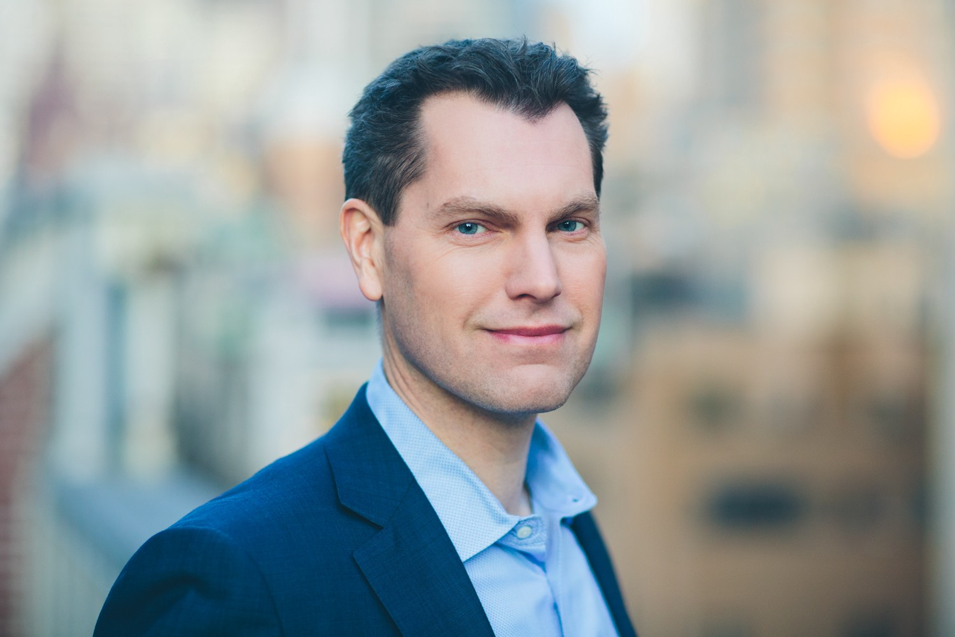

Financial Incentives and the “Performance of Crowds”
Experiment with economic incentives on Amazon Mechanical Turk
An exciting tool for behavioral research, since you can recruit thousands of participants from a real labor market
Notes:
assign participants to a relatively high number of experimental conditions, as well as check the robustness of findings

Slide 66
Impact of compensation
Does compensation change the quantity of work performed (output)?
Does it change the quality of the work (accuracy)?

Slide 67
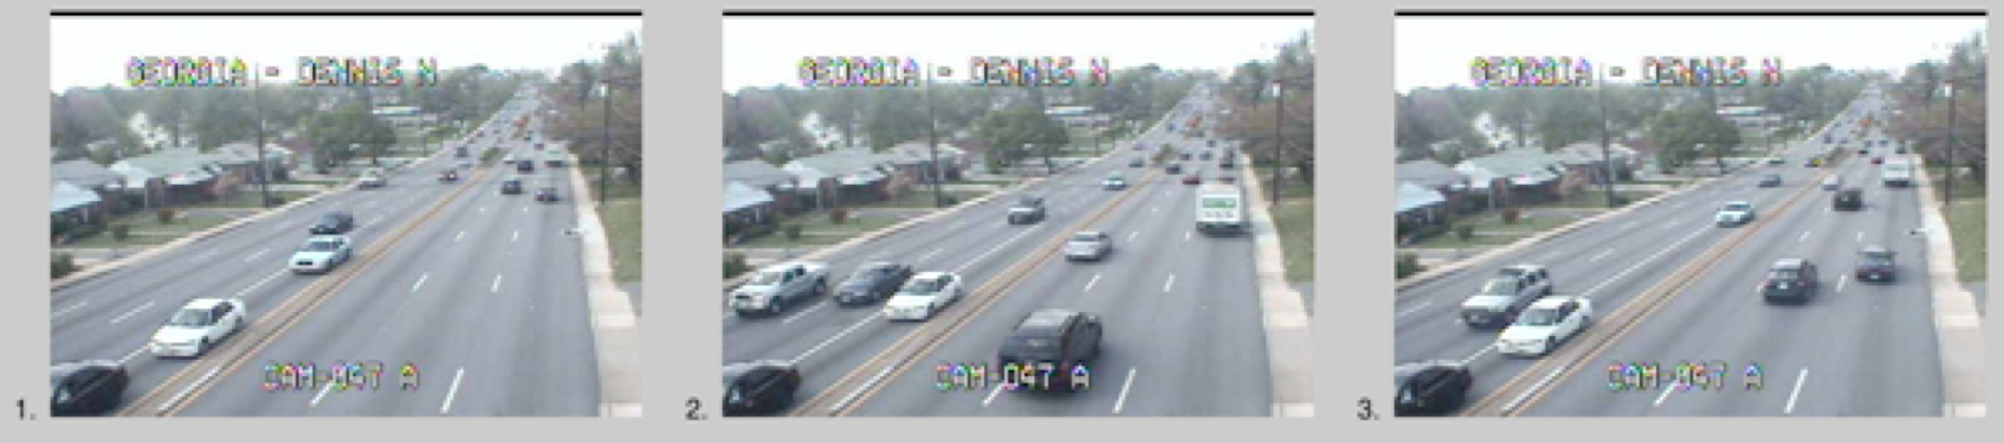
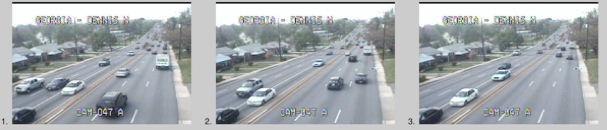
Re-order Traffic Images
Unsorted
Sorted

Slide 68
Payment scheme
Everyone: $0.10 for doing training examples and filling out a survey
Payment levels: nothing, 1¢, 5¢, 10¢ per set
Num images per set (independent of payment): 2, 3, 4
Each person sorted up to 99 sets of images, could end participation at any point and get paid for what they did
611 subjects sorted a total of 36,425 image sets
Notes:
They had a practice run with feedback that told them what to look for, and whether their guess was right.

Slide 69
Reorder Traffic Images
Sort 99 sets of images of moving traffic into temporal order
3 difficulty levels x 3 rates of pay
Base rate pay of $0.10
Some workers were told they would get an additional bonus for each set of images sorted

Slide 70
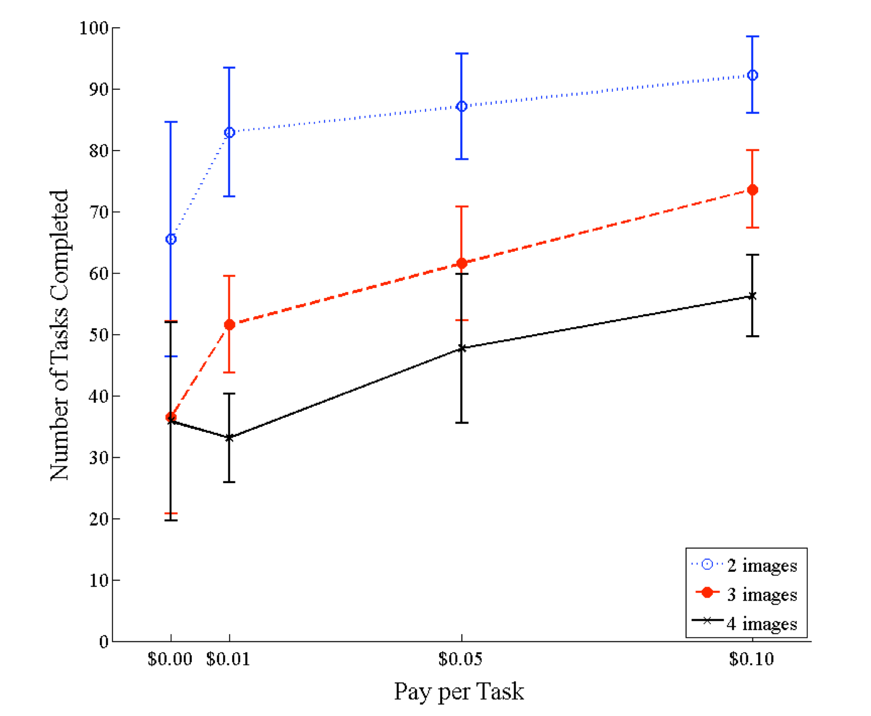
Number of tasks done
Notes:
These results, in other words, are completely consistent with standard economic theory, which predicts that the more a person is paid to do X, the more of X they will do

Slide 71
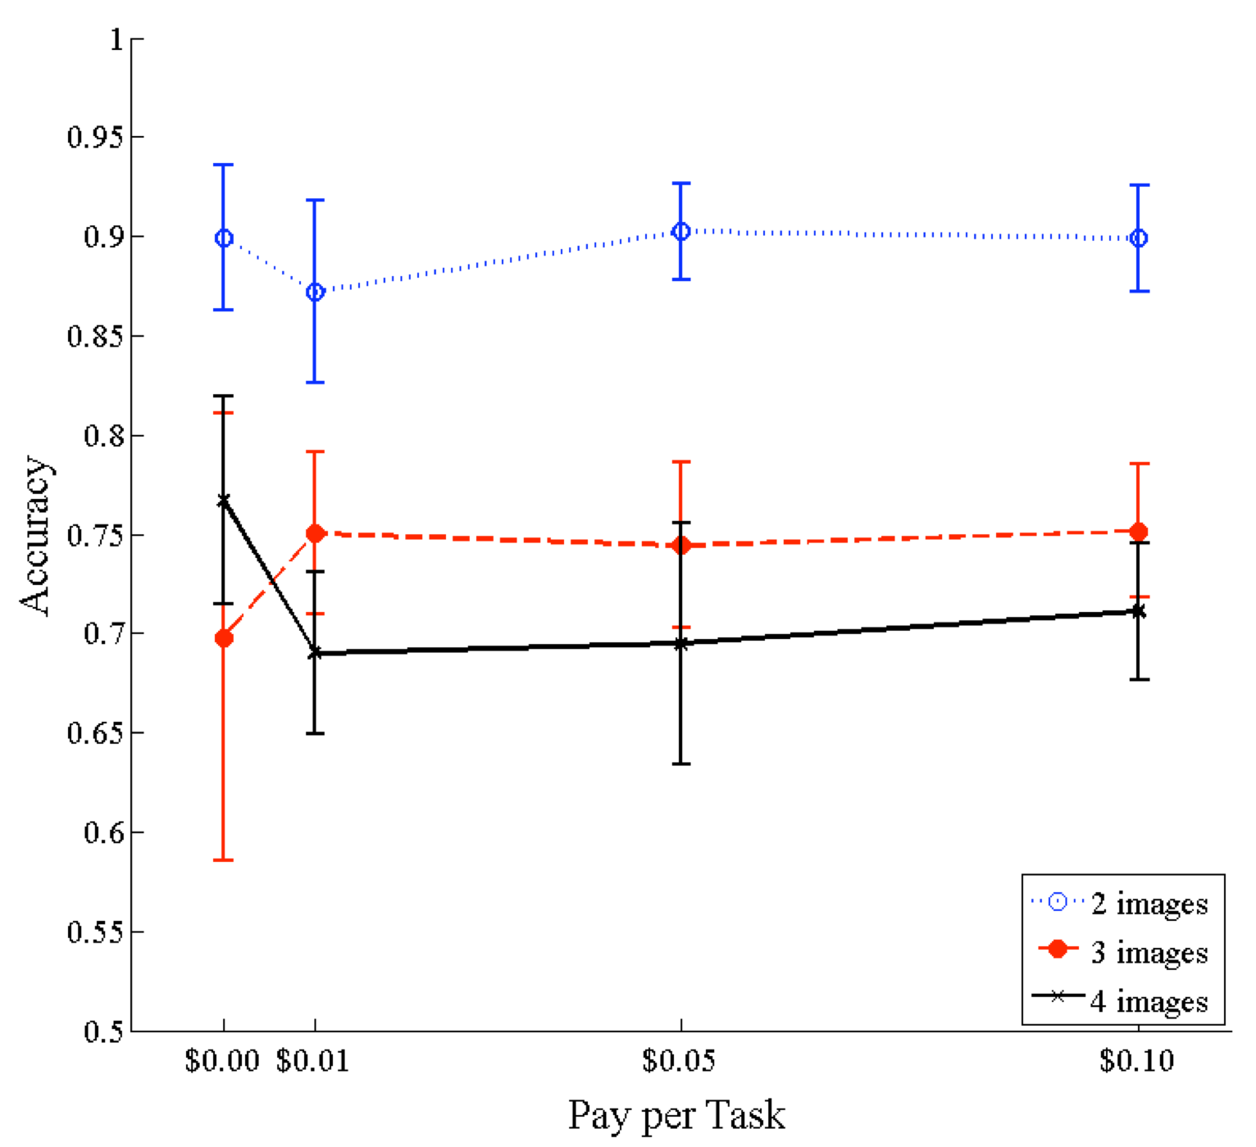
Accuracy
Notes:
increasing compensation did not improve accuracy

Slide 72
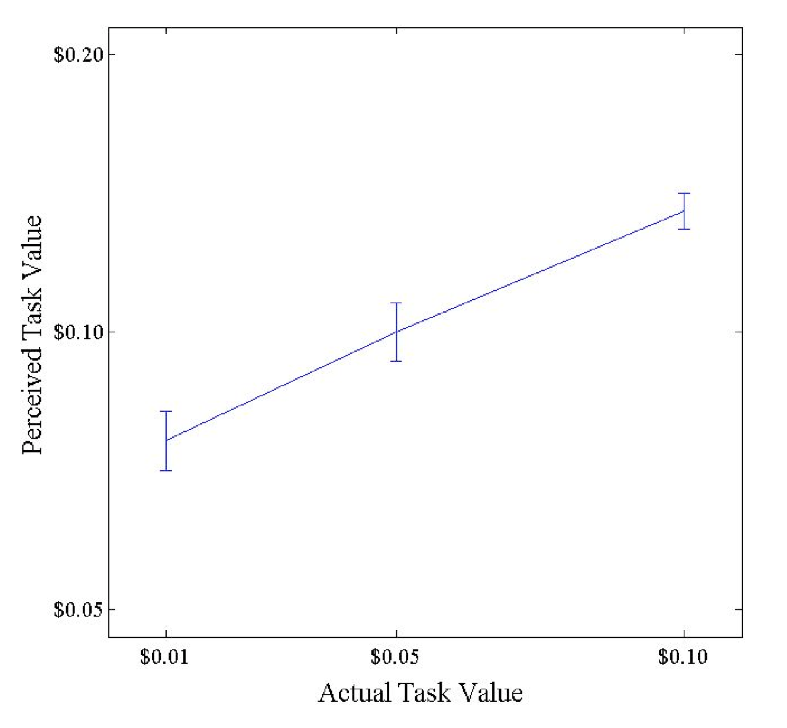
Perceived Value
Notes:
Post-hoc survey shows perceived value of the task increases with the actual pay, but is always slightly greater than the actual pay received.

Slide 73
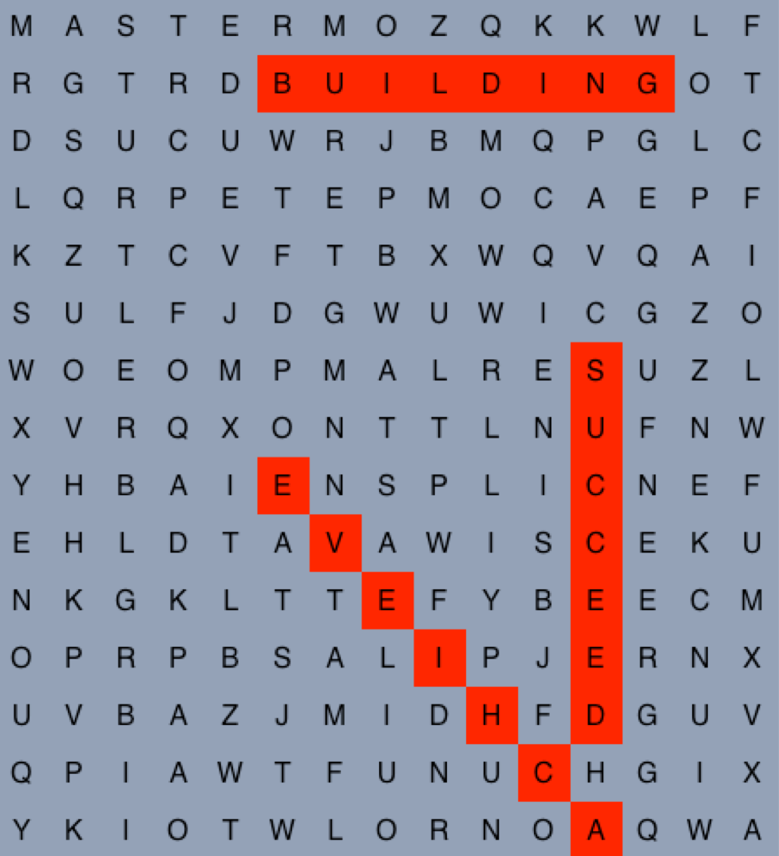
Word Jumble Puzzles
Find as many of the of words in a set as you can:
ACHIEVE, ATTAIN, BUILDING, CHAIR, COMPLETE, GREEN, LAMP, MASTER, MUSIC, PLANT, STAPLE, STEREO, STRIVE, SUCCEED, TURTLE
Not all of the words listed are in the puzzle!
Notes:
but because participants did not know how many words from the list could actually be found in the puzzle,
they could not be certain that they had found all the words.

Slide 74
Experimental setup
Different pay rates (just as before)
Subjects were told that they would be paid either on a per-grid basis or a per-word basis, or not told anything
quantity = number of puzzles completed quality = fraction of words found per puzzle
Participants could do up to 24 puzzles
320 subjects solved 2736 puzzles, finding 23,440 words

Slide 75
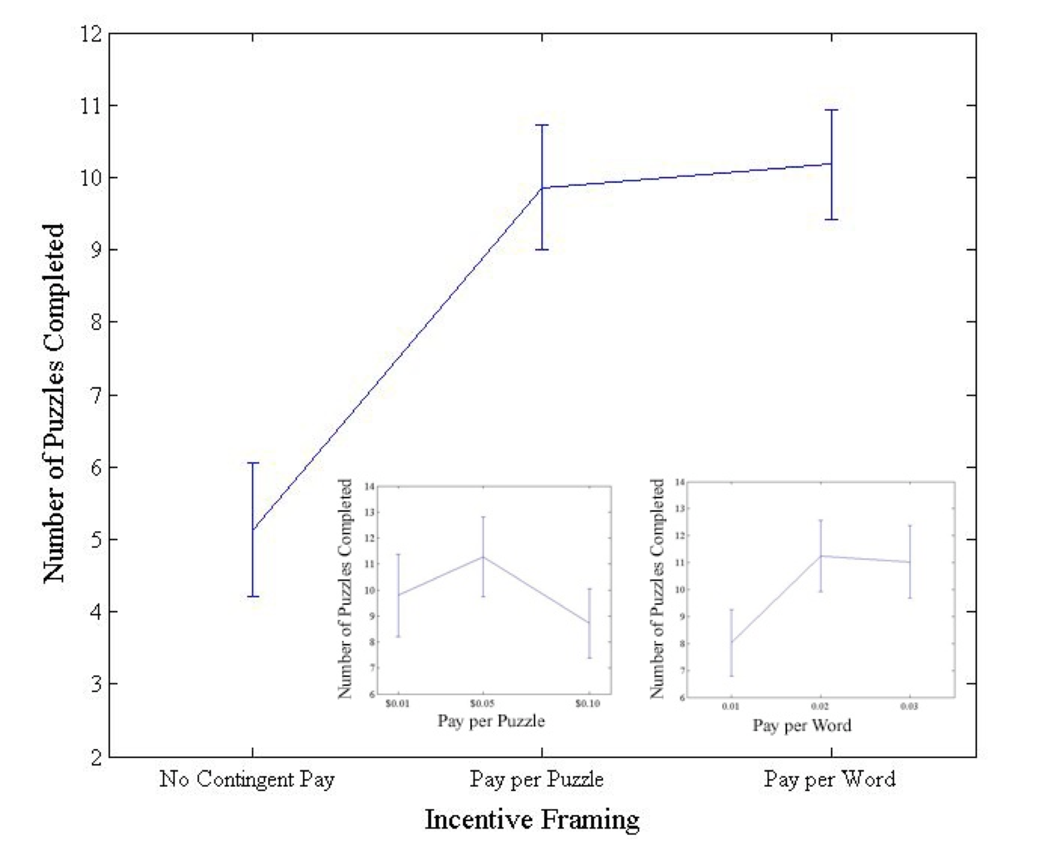
Fun v. pay
Notes:
Completed more puzzles if paid, but not more on the basis of whether it was per word or per puzzle.
ccb - todo - recreate these graphs as vector graphics

Slide 76
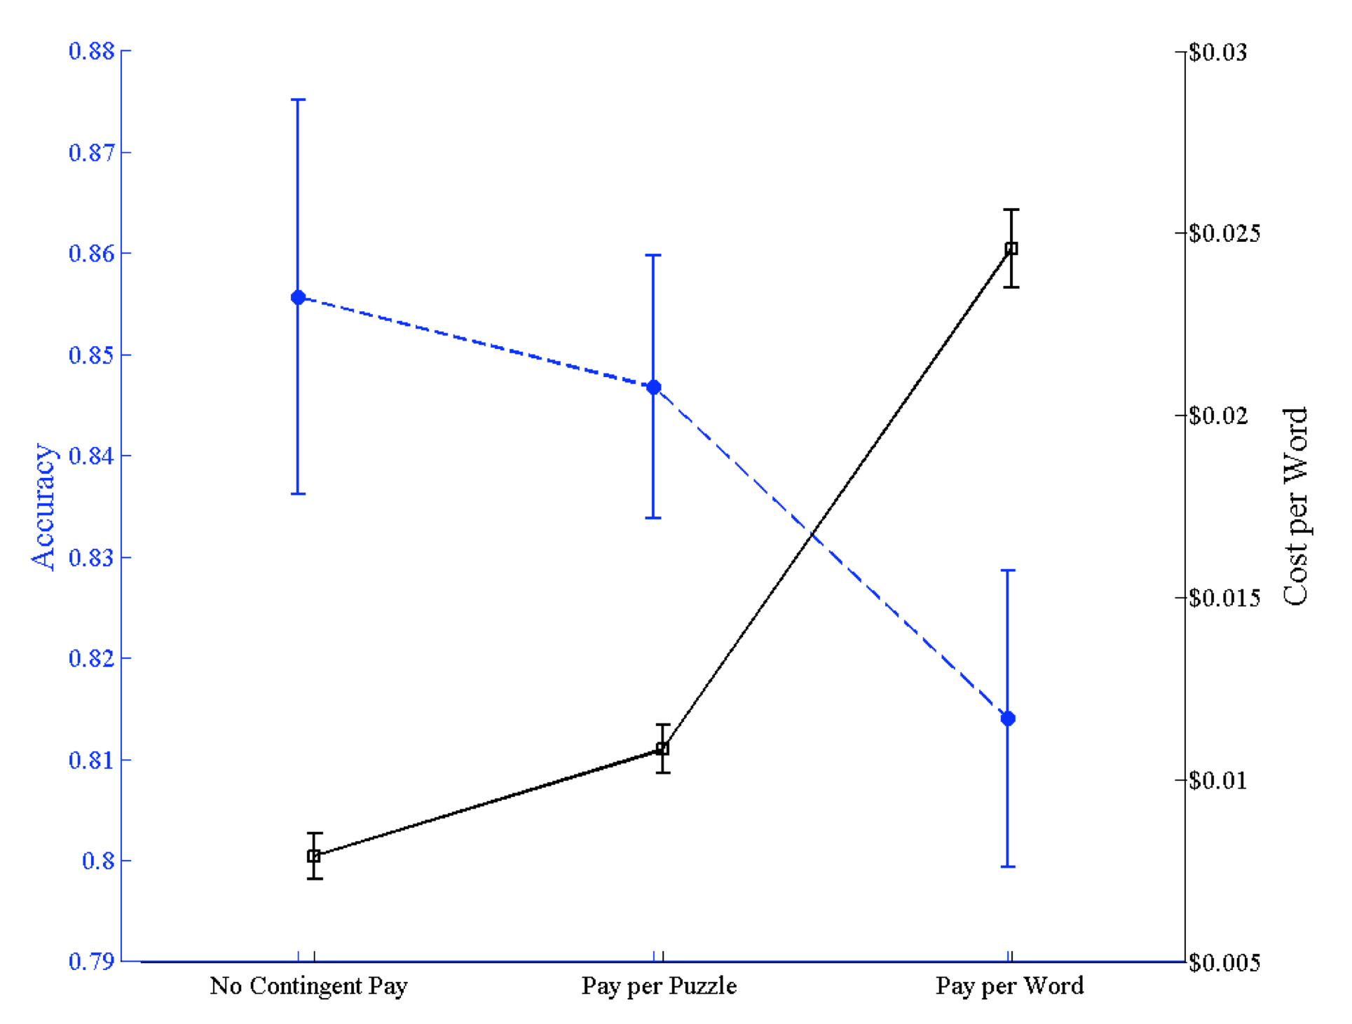
Compensation doesn’t affect accuracy
Notes:
Participants were paid more in total (solid line) but found fewer words per puzzle (dashed line) in the pay per-word condition than in the pay per-puzzle condition.

Slide 77
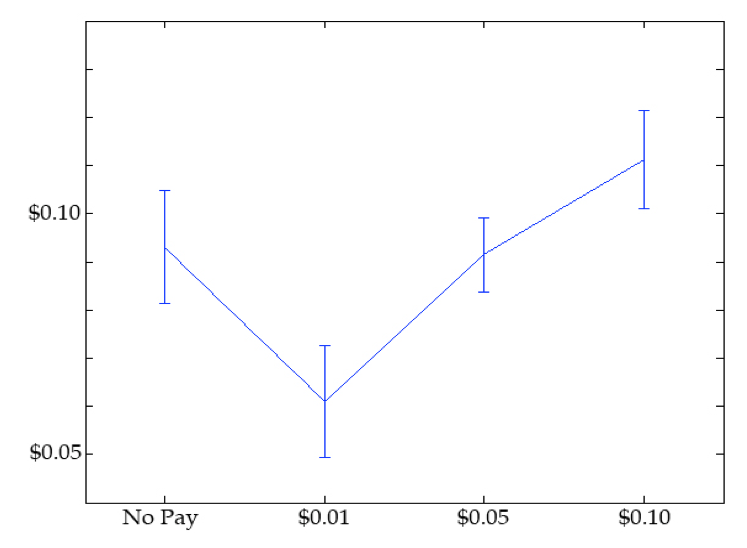
Perceived Value
Notes:
No Pay = No anchoring effect

Slide 78
Findings
Paying subjects elicited higher output than gamification, and increasing pay rate yielded even higher output
However, paying subjects did not affect their accuracy
Anchoring effects are significant – the reward you set impacts perceived value

Slide 79
Implications for your tasks?
When you can use non-financial rewards, like intrinsic motivation, do so, since the quality of work will be the same
When you can’t use intrinsic motivation, it might be in your best interest to pay as little as possible. Your work will be done slower, but quality will be similar.
Is this fair to workers?

Slide 80
What do you think?
Is studying workers on Mechanical Turk a valid way of studying other labor markets?
What possible confounds are there?
What could we do to control for them?

